Slide 1
New York City
Does Bad Weather make it worse?

Slide 2
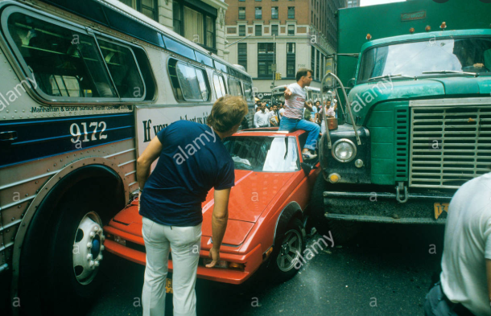

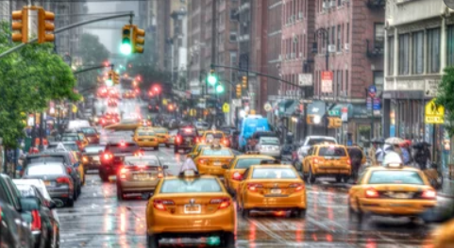
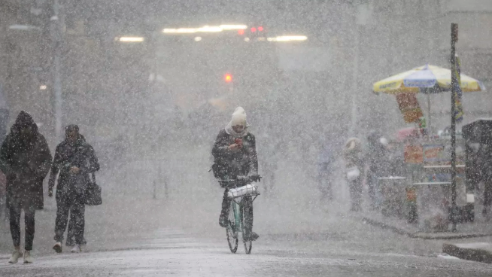
Living in the Big Apple – Does Bad Weather…
…cause more accidents?
…put more folks in cabs?
…cost more to heat your home?

Slide 3
Data Gathering
(The Hardest Part of the Project)

Slide 4
Where to Start?
Air Quality Index
BigQuery
SQL Skills
Got Scary
India Air Quality Index
Only one dataset
Less comparing
Not as rich of a data source
Canadian Political Results with Immigration Changes
Well…
Got too
Political
Endangered Languages comparison to Goodread Dataset
Turns out endangered languages
Don’t write books….
(Might be part of the problem?)

Slide 5
Big City Living
Need discussion as to why we picked the final project

Slide 6
Main Data Sources
Kaggle Kaggle Kaggle
**Insert Weather Link Here**
**Insert Car Accident Data Here**
**Insert Cab Data Here**
**Insert Weather Data Here**
Commonality: Date & Hour Data

Slide 8
Data Merging Challenges
Date & Hour Data
All Data Sets Required Same Data Formatting for Merging
But Date & Time not necessary for Analysis:
Date/Time | Temperature (ºC)
Date/Time | Weather Condition | #Accident
Temperature (ºC) | Weather Condition | #Accident

Slide 9
Weather
Does Weather Conditions have an impact on # of accidents that occur?

Slide 10
Graph of Weather Type with

